Slide 1
Car Price Prediction
Team Members:
Abdul Rahim
Arfam Alam
Anisha Garg
Deepika Sharma

Slide 2
Introduction
Estimating price of used car’s is a big problem. Even experts may give varying estimates for a given vehicle. This sometimes leads to exploitation of uninformed consumers.
Usually people are unaware of market price of their used vehicles and they end up selling it at a very low rate.
On the contrary an unaware buyer may buy a used vehicle at a ridiculously high price.
Predicting used vehicle price is also beneficial for companies which sell new vehicles at exchange offers(exchanging old vehicles for new), buyers also benefit, since they get fair price for their used vehicle.
Car price prediction algorithms attempt to predict price of used cars, such algorithms can be implemented in online shopping websites, 2nd hand online markets, and can also be used by dealers to maximise their profit.

Slide 3
Objective
The objective of project is to predict price of used cars using machine
learning.
We use various machine learning algorithms such as linear regression,
decision tree regression, random forest regression.
At the end we compare all three algorithms to conclude the best algorithm
for the same.

Slide 4





Software Used And Required to Run
Python 3.10.0
The following libraries should be installed within python.
pandas
matplotlib
seaborn
sklearn

Slide 5



Any IDE for running and executing code.
Recommended IDE’s:
Visual Studio Code
Spyder
Jupyter Notebook
PyCharm
Atom
For our project we will use jupyter notebook.

Slide 6

Hardware used and required to run
We use HP Victus with the following specs:
Processor: AMD Ryzen 5 5600H
Graphic card: AMD Radeon RX5500M
Ram: 8 GB
Any hardware would work which can run the previously listed applications.

Slide 7
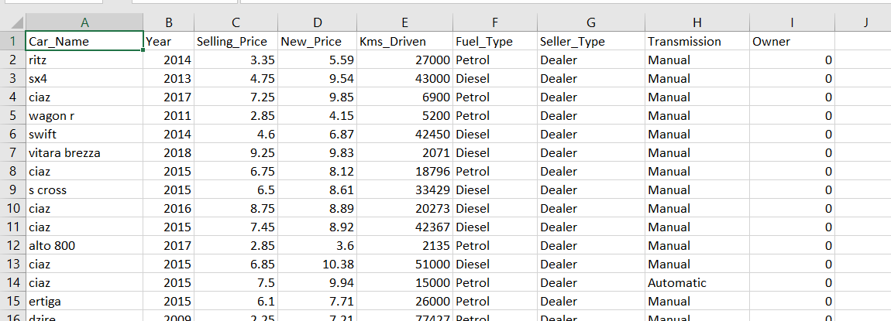
Data Set
We use our dataset from Kaggle called ‘car price.csv’, click here to get the data.

Slide 8
Screenshots

Slide 9
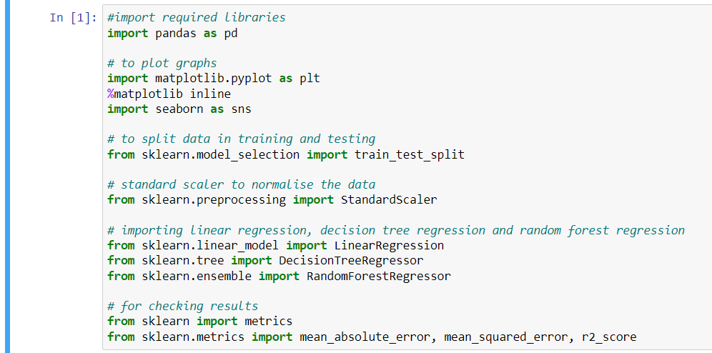
Importing Required Libraries

Slide 10
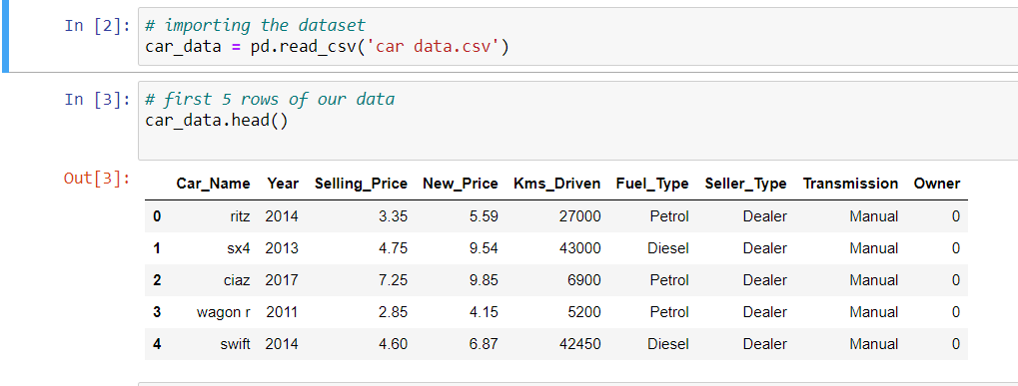
Importing Dataset

Slide 11
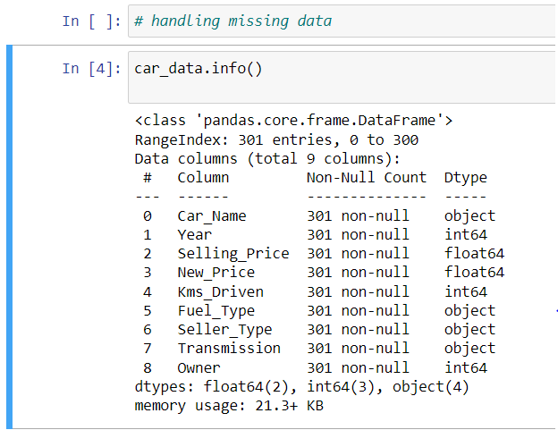
Data Pre-processing
car_data.info() returns more information about the data.

Slide 12
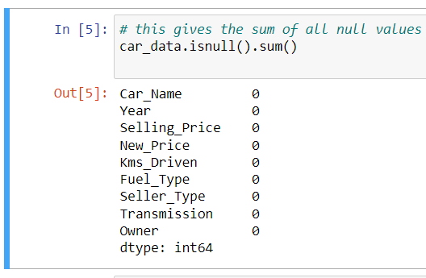
Handling null and missing values: car_data.isnull().sum() returns the sum of null values for each column. From this fig. we can infer that there are no null values in our data.

Slide 13
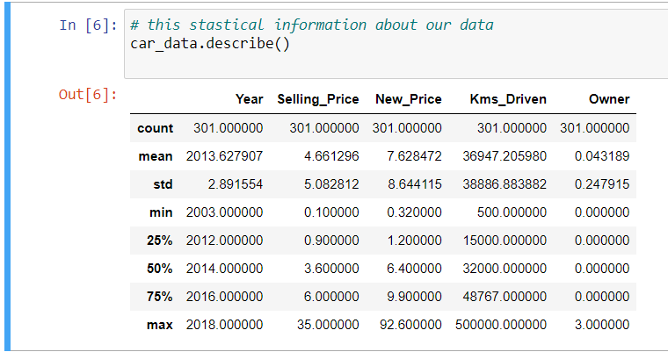
Car_data.describe() returns stastical information about data.

Slide 14
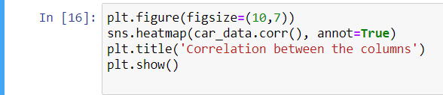
Heatmap
Heatmap shows us correlation of dependent variables with each other, for
a good dataset the correlation between dependent variables should be minium.

Slide 15
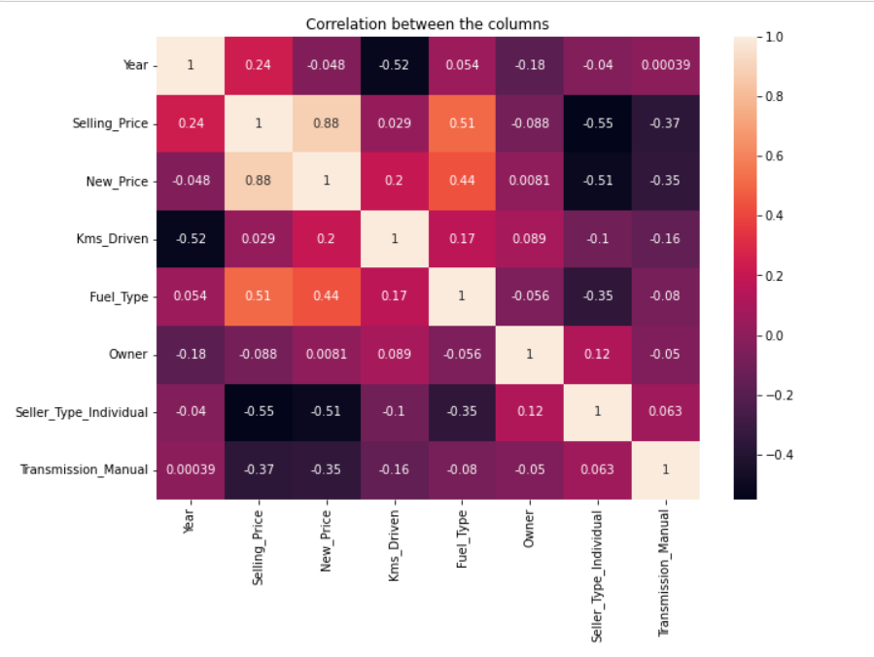
As we can see there are no variables that are highly correlated (> 90%), we can proceed further.

Slide 16
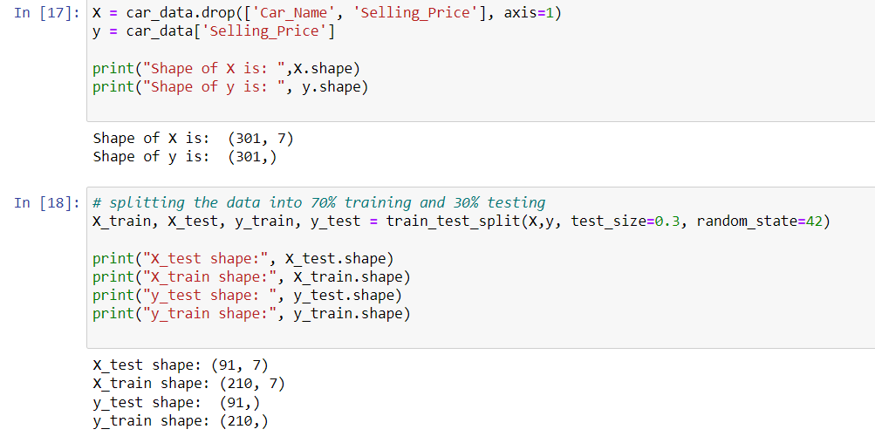
Splitting dataset into testing and training
We split the dataset into 70% training data and 30% testing data.

Slide 17
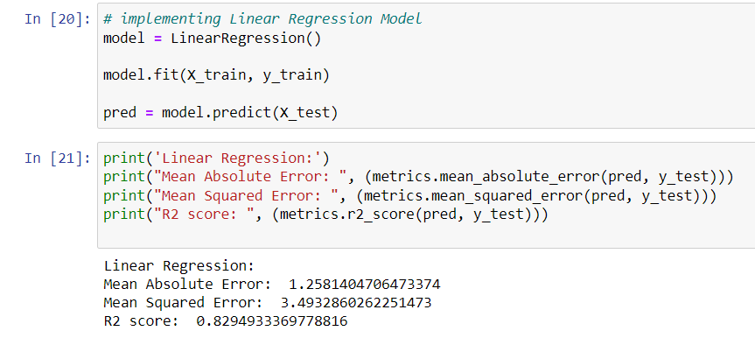
Linear Regression

Slide 18
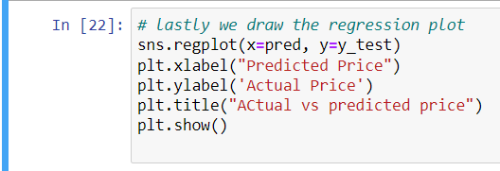
Regression plot: Regression plots as the name suggests creates a regression line between 2 parameters and helps to visualize their linear relationships.

Slide 19
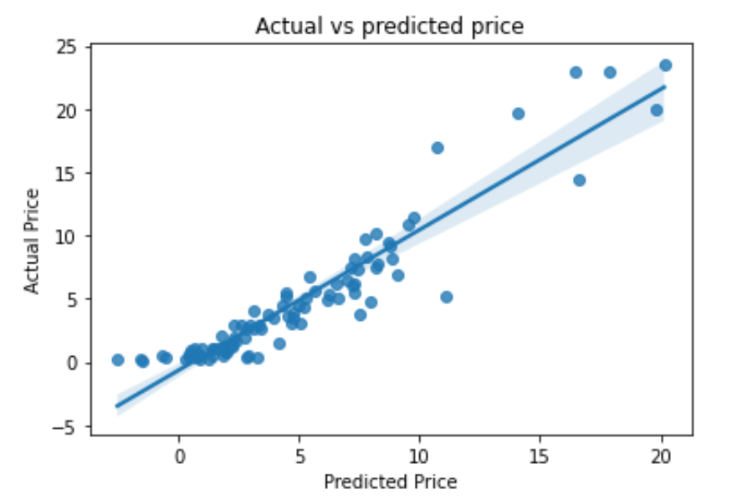

Slide 20
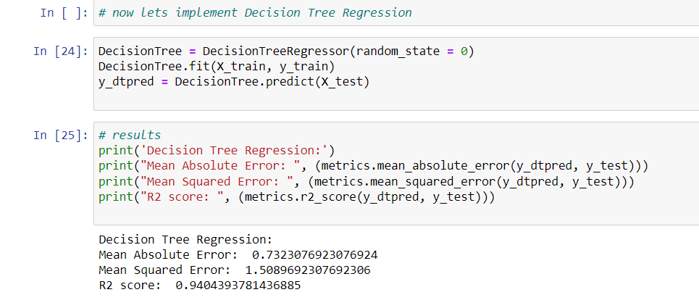
Decision Tree Regression

Slide 21
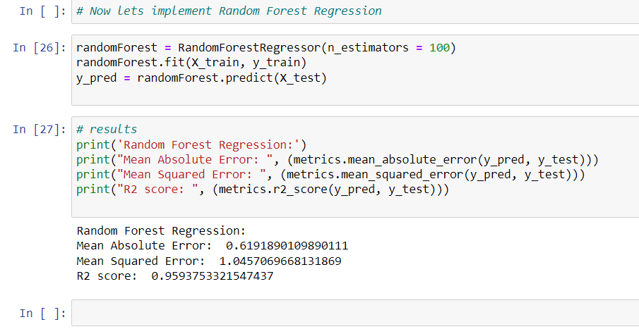
Random Forest Regression

Slide 22
Comparing Algorithm Performance
We compare the algorithms using R squared value, Mean Absolute Error(MAE), Mean Squared Error(MSE).
R2 score: The proportion of the variance in the dependent variable that is predictable from the independent variable(s). R2 score varies between 0 and 1, algorithm with higher R2 score is better.
Mean Absolute Error (MAE): The magnitude of difference between the prediction of an observation and the true value of that observation. Algorithm with lower MAE is better.
Mean Squared Error (MSE): Mean square error (MSE) is the average of the square of the errors. The larger the number the larger the error. Algorithm with lower MSE is better.

Slide 23
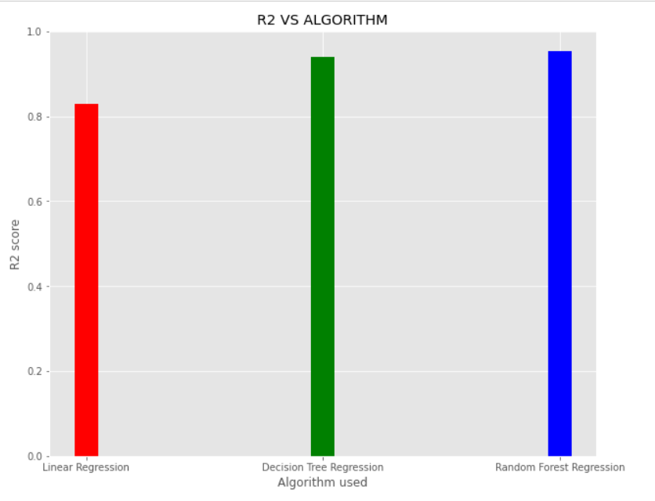
Clearly random forest regression (r2 = 0.95) performs better than decision tree regression(r2 = 0.94) and linear regression(r2 = 0.82).

Slide 24
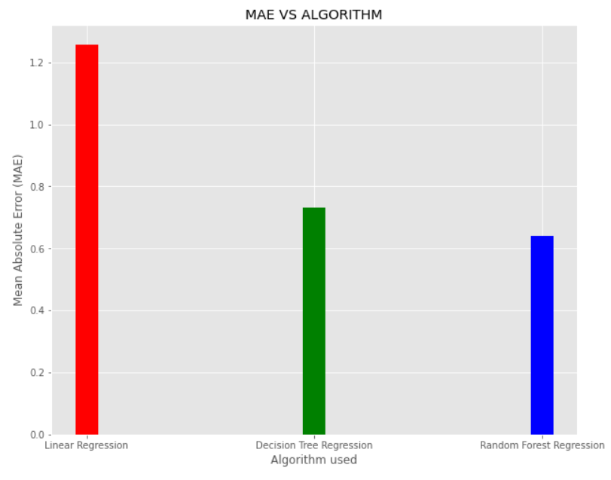
Here random forest regression performs(0.64) better that decision tree regression(0.73) and linear regression(1.25).

Slide 25
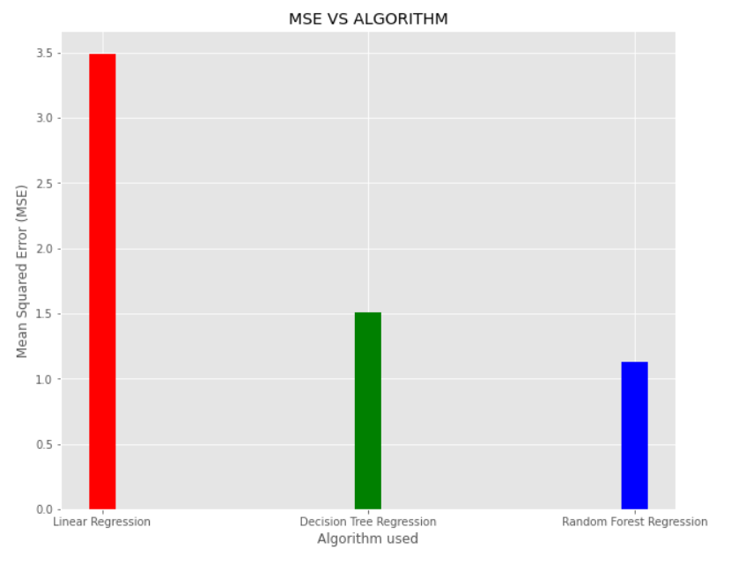
Here also, random forest regression(1.13), performs better than decision tree regression(1.50) and linear regression(3.49).

Slide 26
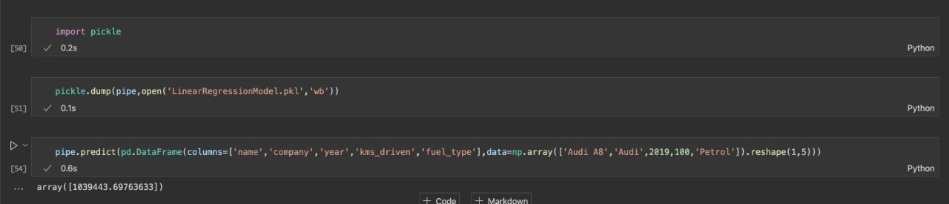
Displaying Result

Slide 27
Conclusion and Future Scope
We conclude that random forest regression is the best technique for determining used car prices.
In future, datasets with more features which take into account the repair history, condition of the car, etc, will provide better accuracy.
These algorithms will standardize the values of used vehicles, which will be very beneficial for the customers and buyers.
These algorithms can be used in online platforms(such as OLX, Car Dekho etc,) dedicated to reselling of used vehicles.

Slide 28
Thank You

